Slide 1
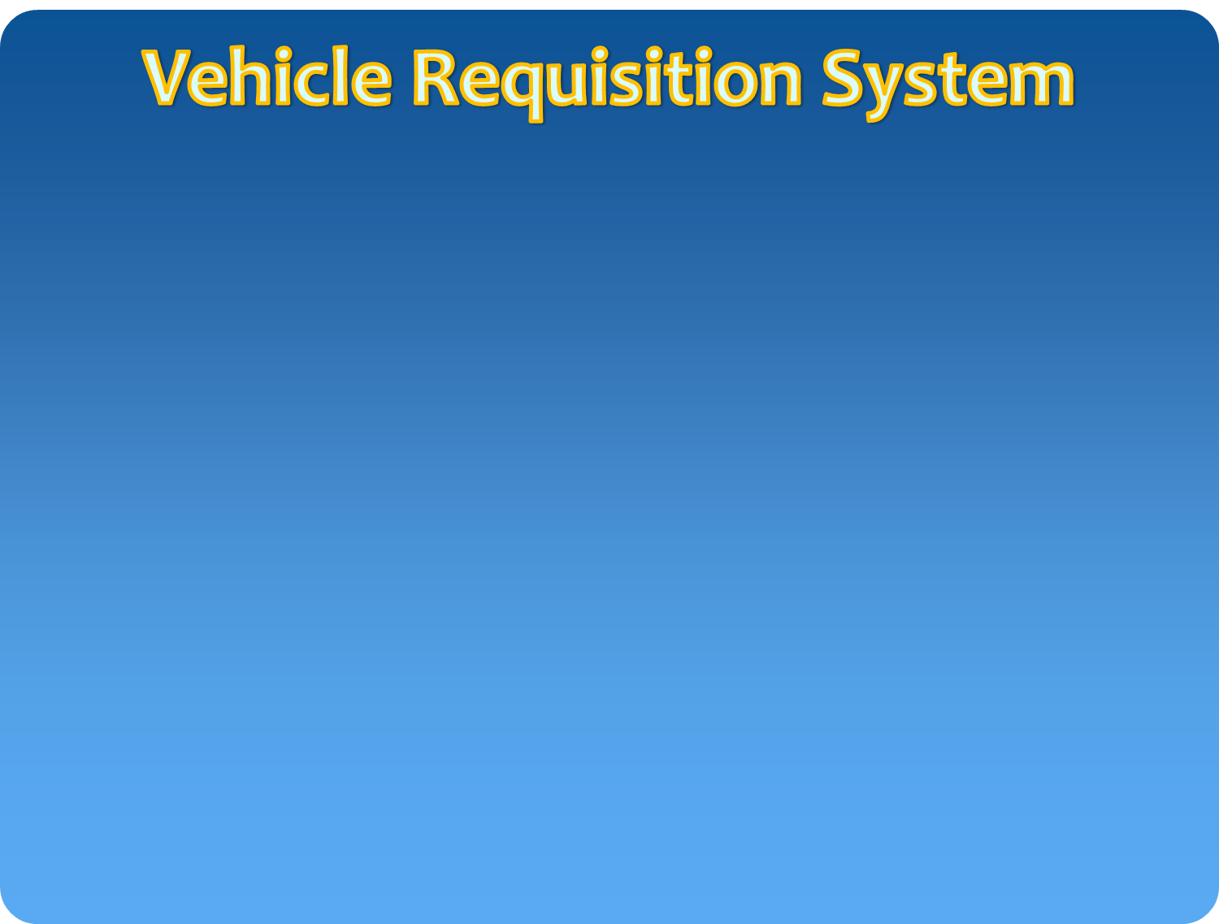


A Software to make the Vehicle Requisition process smarter

Slide 2
Contents
Introduction
Audience / market
How the program will work
Software development process
The final product
Technical specifications
Availability
Training
More information & updates
Project partners
Acknowledgements

Slide 3
Introducing: a new software program
A tool for simplifying documents and text
Primarily for people who wants to request for a vehicle requisition
Using MVC platform and computerized automated technologies
It removes the need for paper works
Developed by a team of BKIICT students

Slide 4
Audience / market
Primarily for the organizations needed to manage a large number of vehicles rent process
Also useful for –
Organizations who have vehicle requisition facilities
Organizations want to reduce paper work
Organizations want to make the rent/requisition process smarter.

Slide 5
How the progam will work
It is a web based application
People request for rent/requisition using their web browser through internet
A controller will get the request through internet and will assign a vehicle against the request
Controllers action will send as a notification to the requester and then driver of assigned vehicle

Slide 6
Software development process
Identifying user requirements
Processing structural complexity of languages
Processing ambiguity in meaning of words
Designing system architecture & user interface
Generating personalized documents
Testing & evaluation

Slide 7
Software development process
Designing system architecture & user interface
Combining the parts to create a functioning software system
Designing a user interface for people with Autism that contains minimal visual distractions
Designing a user interface for intermediaries who will help people with Autism to use the software
User interface will be accessible on desktop, laptop & tablet computers (if there is enough demand, also on for hand-held devices)

Slide 8
The final product

Slide 9
Technical specifications

Slide 10
Availability
Beta version is expected to be available for public use and testing in 2018
Final version is scheduled for release late 2018
Product launch will be held in 2018

Slide 11
Training
Training will be available for professionals in 2018

Slide 12
More information & updates
Check website for updates: http://www.first-asd.eu
Join our mailing list: news@first-asd.eu
Contact us: contact@first-asd.eu

Slide 13
Project partners
BKIICT
BCC

Slide 14
Objectives:
Issuance of requisition letters for vehicles.
Generation of log book.
Generation of payment calculation chart and release order.
Information about payment / POL to vehicle owners.
Capturing of vehicle details with address, Mobile number and bank details of Owner & Driver.

Slide 15
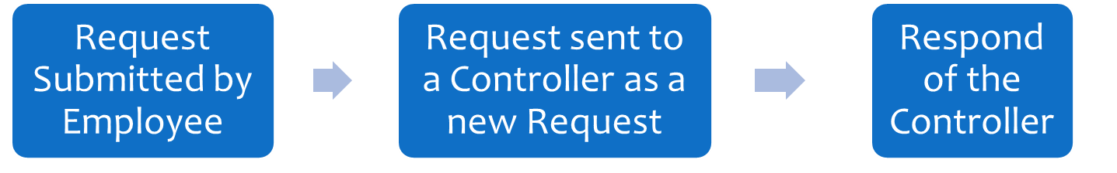
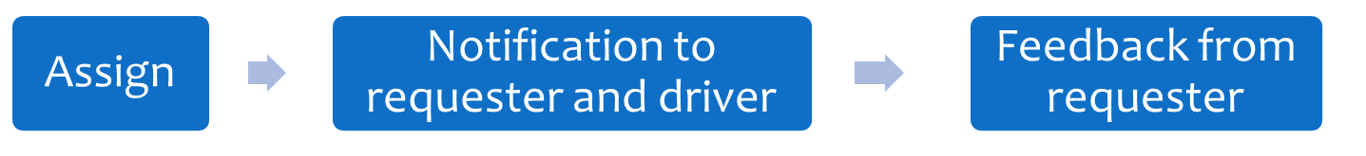
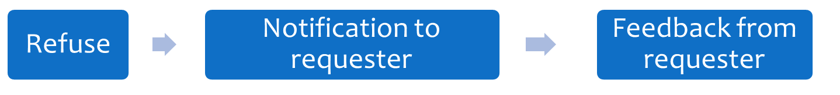
Process flow

Slide 16
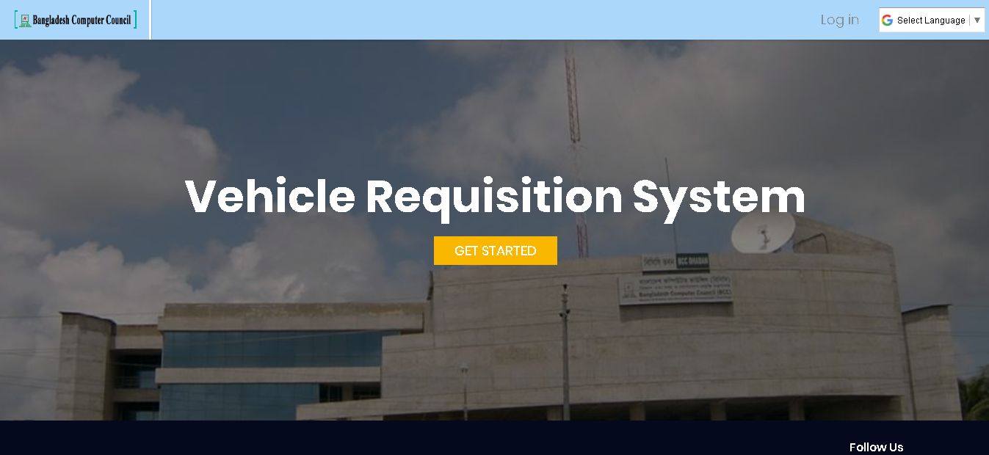
Login-page

Slide 17
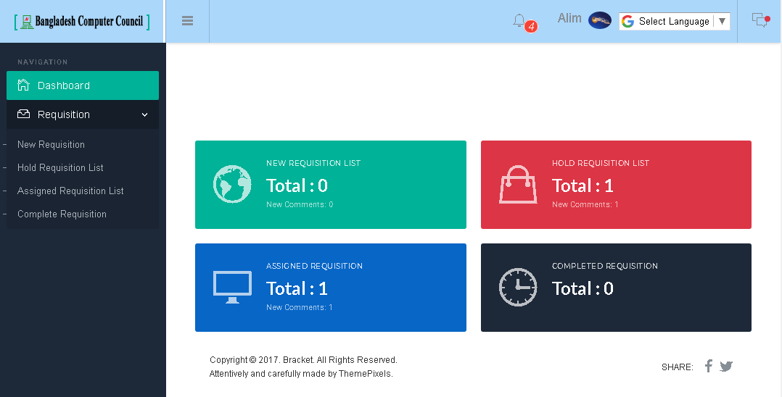
Employee Dash Board

Slide 18
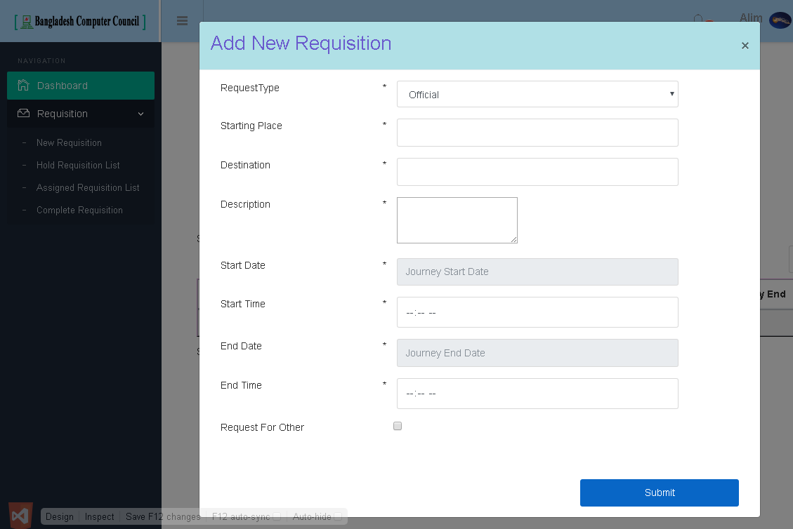
Requisition entry

Slide 19
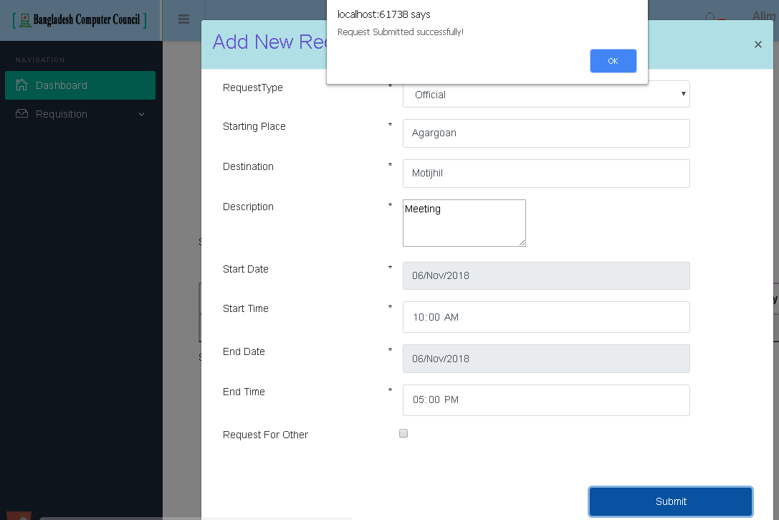
Requisition entry

Slide 20
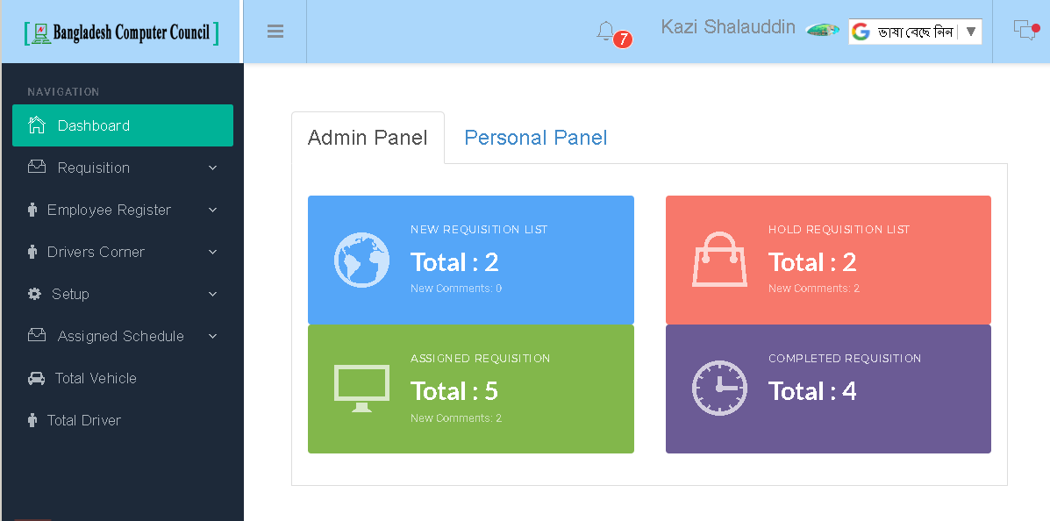
Admin Dash Board

Slide 21
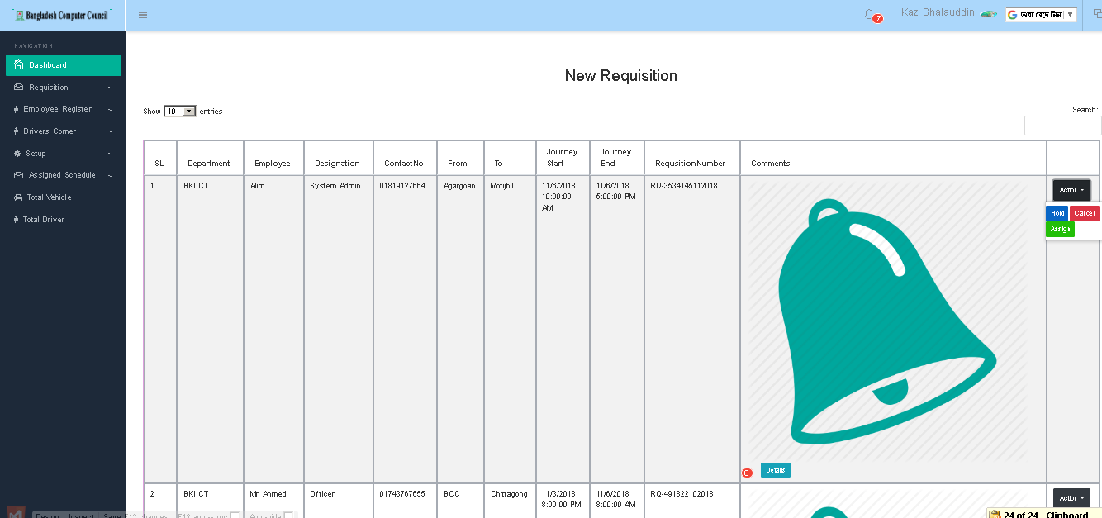
Admin Awaiting requests panel

Slide 22
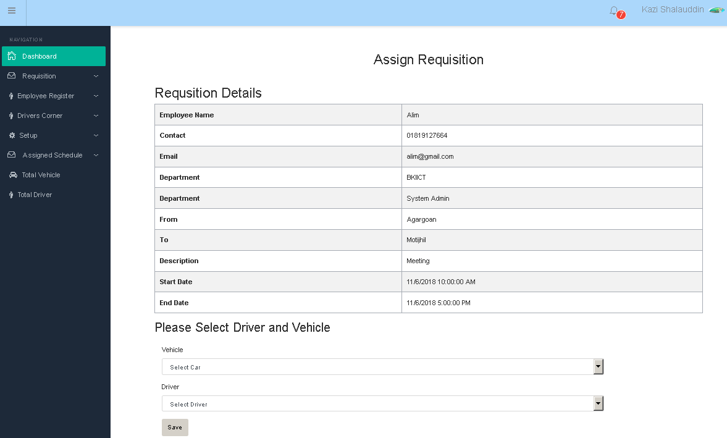
Admin requests assigning panel

Slide 23
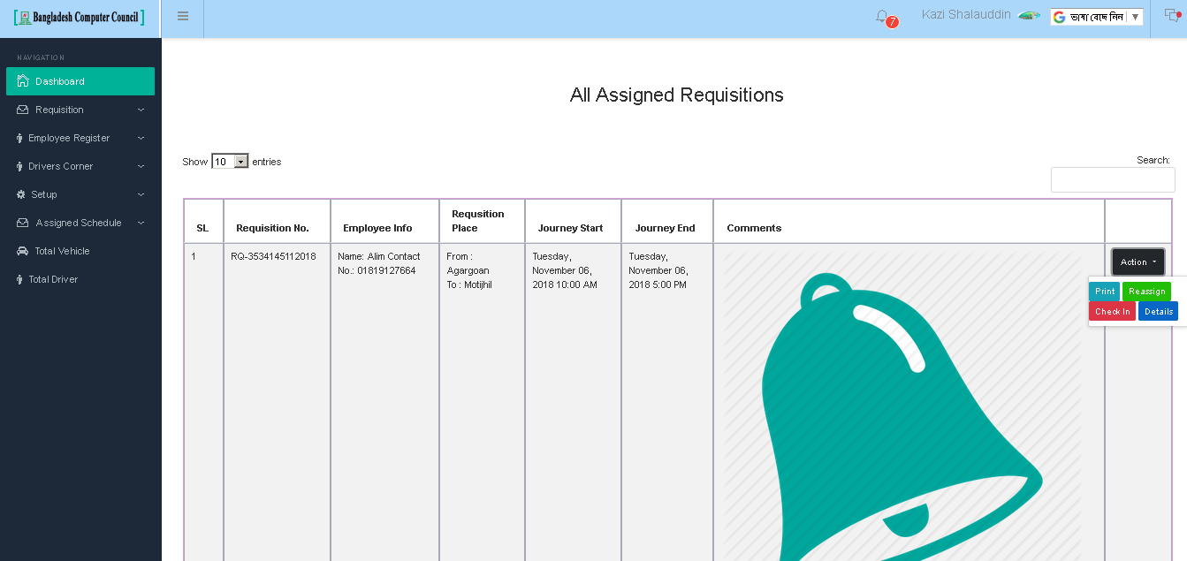
Admin assigned requisitions list

Slide 24
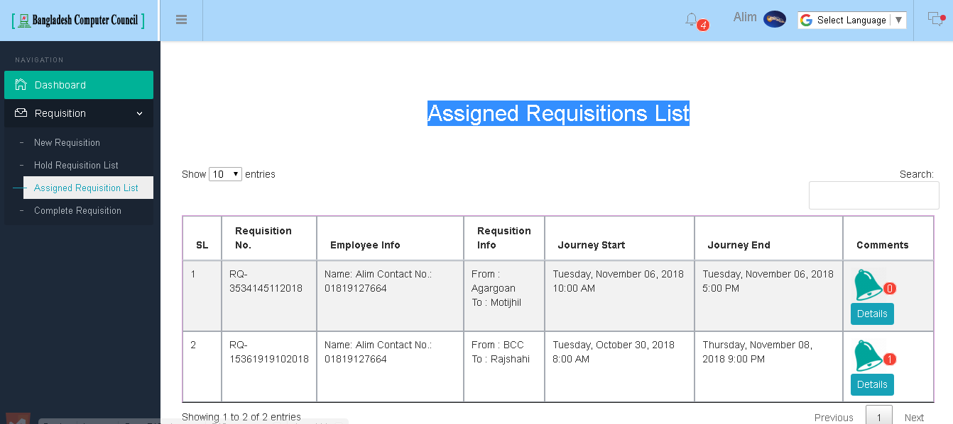
Employee’s Assigned Requisitions List

Slide 25
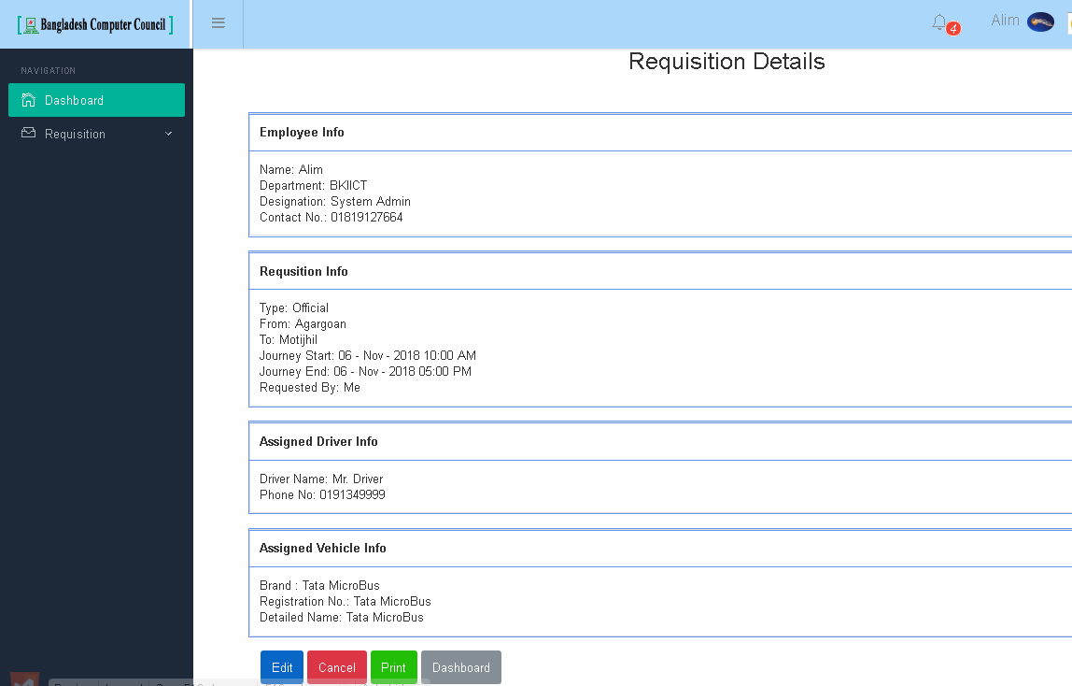
Employee’s Assigned Requisitions List

Slide 26
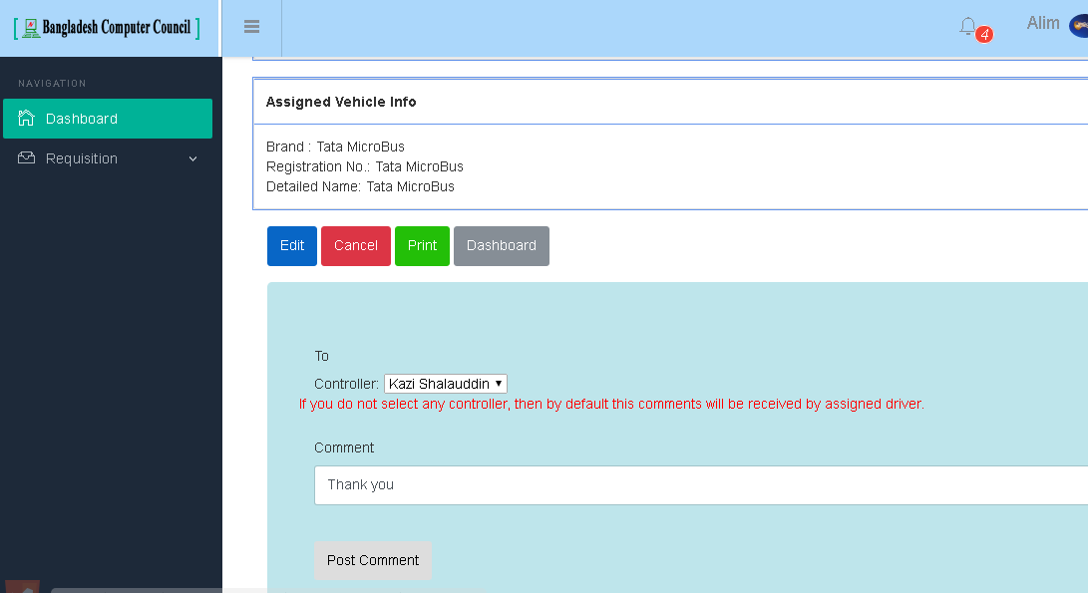
Employee’s feedback

Slide 27
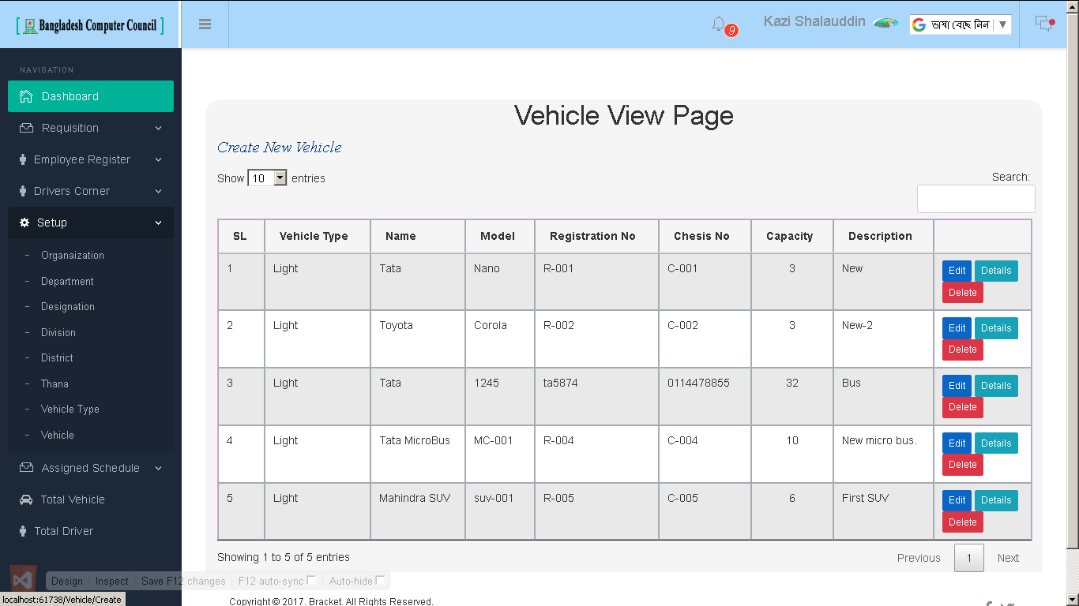
Administrative setup page

Slide 28
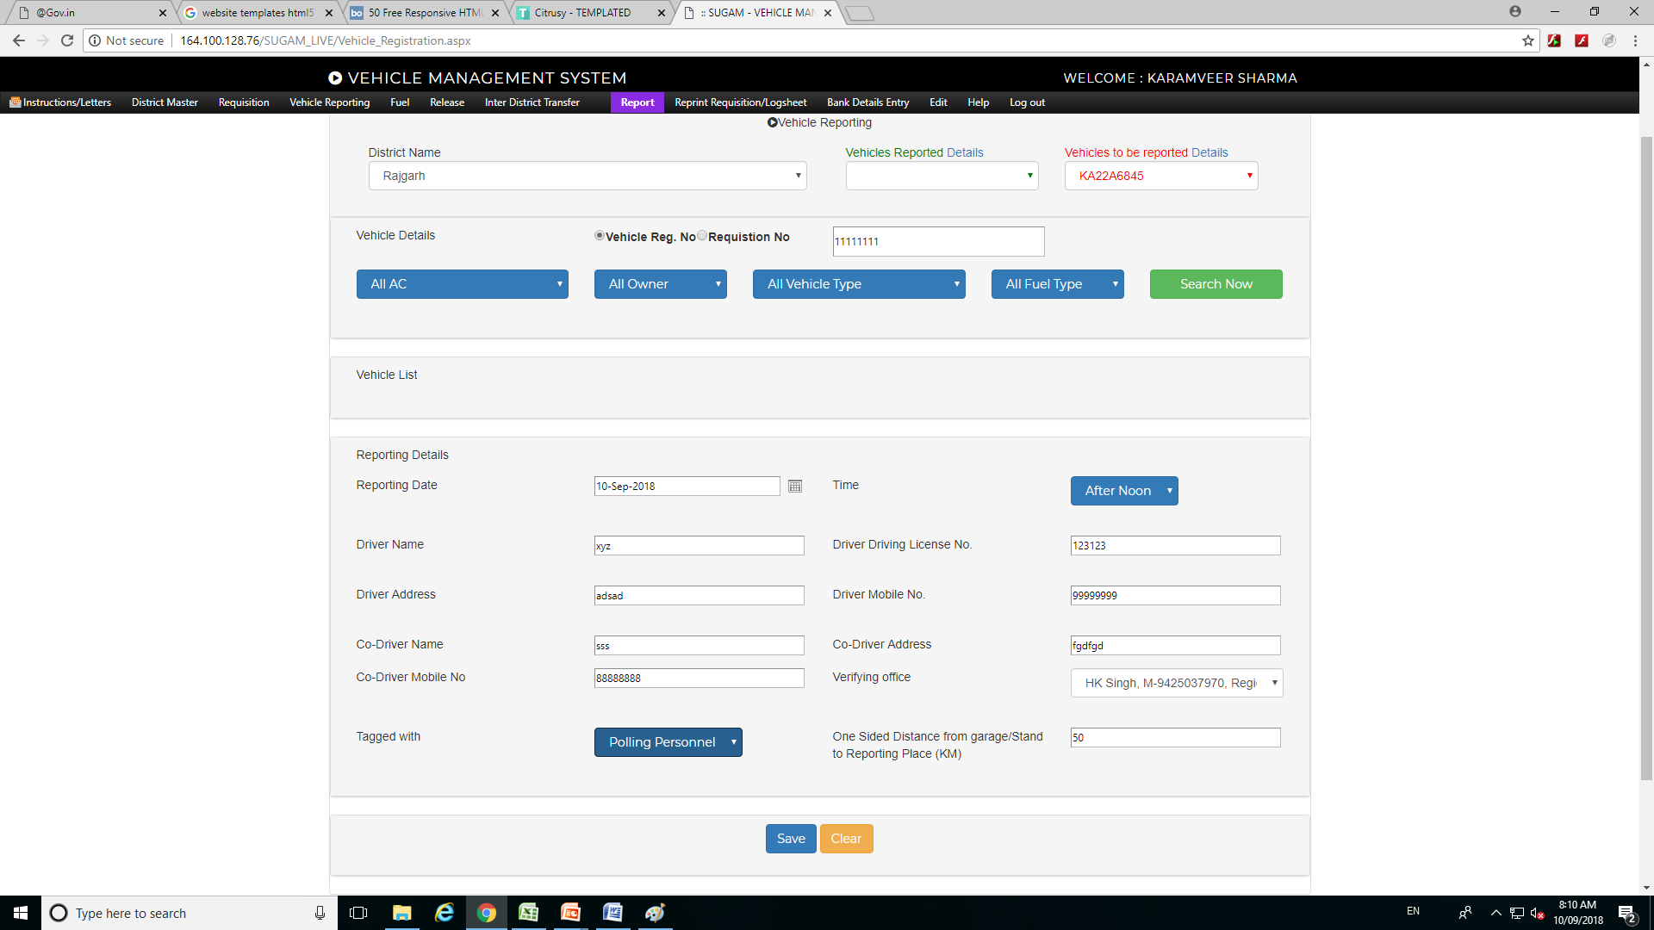
Vehicle reporting

Slide 29
System architecture
A system is a set of interacting components forming an integrated whole
Architecture is a description of the individual components and their interactions
  Collection of models describing the system from different views

Slide 30

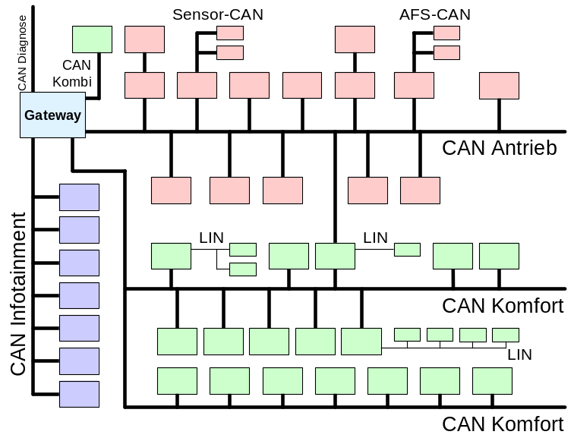
Network architecture of a car
Electronic Control Unit (ECU)
  Sensors and actuators
  Microcontroller
  Software
Bus
  Connects individual ECUs
Interconnect between buses

Slide 31
Outline
Functional domains
Network architecture of a car
Requirements for function realizations

Slide 32
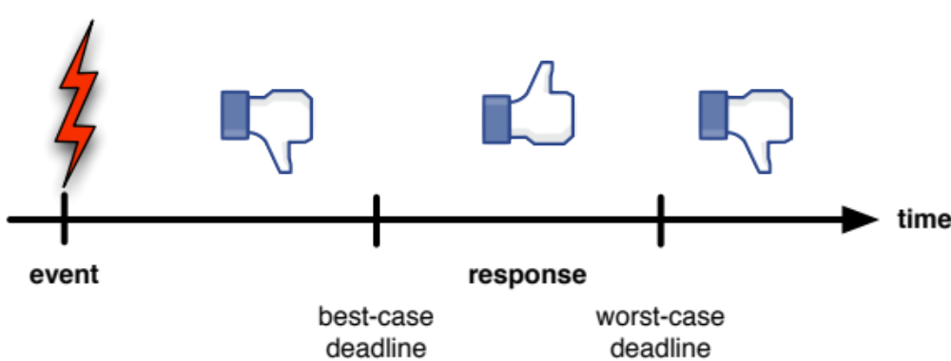
Timeliness requirements
Example: inflation of an air bag
  real-time ≠ fast
  real time: fulfill specific timing requirements
Notes:
29
This slide alreadyintroduces the essentialelements of real-time systems;
event, response, and deadline(s).
Fromthisexample, itimmediatelyfollowsthatresponses shouldnotbe “toofast”.
Stateddifferently, itprovides a “reasond’etre” for “best-case deadlines”.
In many cases, we willonlyencounter “worst-case deadlines”.

Slide 33
Timeliness requirements
Example: Software controlling the deployment of airbags has 15 to 40 milliseconds to determine which and in what order to activate
Specification:
  Lower and upper bounds on the response time
Metrics:
  Worst-case response time
  Tardiness
Notes:
Response time = latency

Slide 34
Dependability requirements
Specification in 3 dimensions:
  Availability: readiness for correct service
    Metric: probability of the system being ready to use
      Mean Time To Failure (MTTF), Mean Time To Repair (MTTR)
      Availability: MTTF/(MTTF+MTTR)
  Reliability: continuity of correct service
    Metric: expected time until not being available
  Safety: absence of catastrophic consequences on the user and the environment
    Metric: catastrophic states are not reachable

Slide 35
Safety requirements
The controlled system must remain safe
  hazardous states unreachable (e.g., extremely high temperatures)
  even in erroneous conditions, safety must be maintained (no “error exit”)
Certification: approval by independent agency

